Slide 1
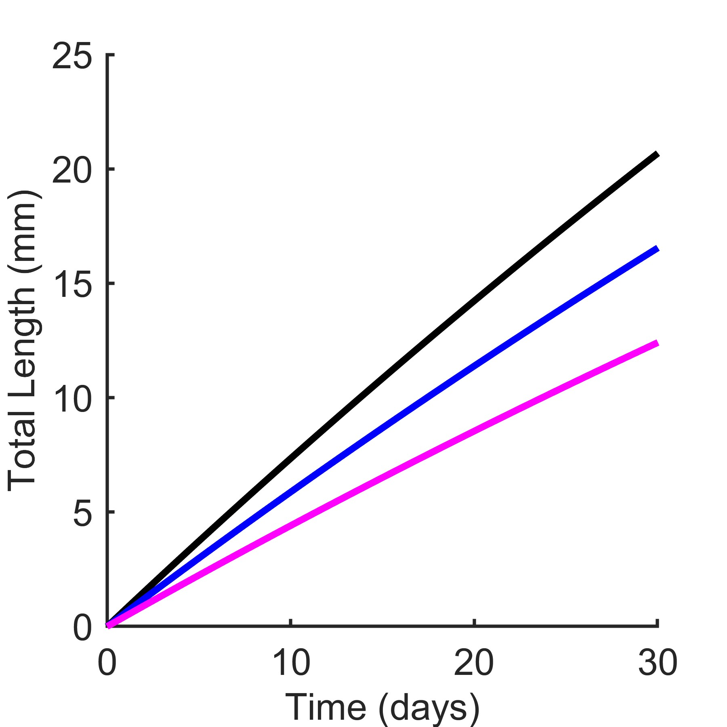
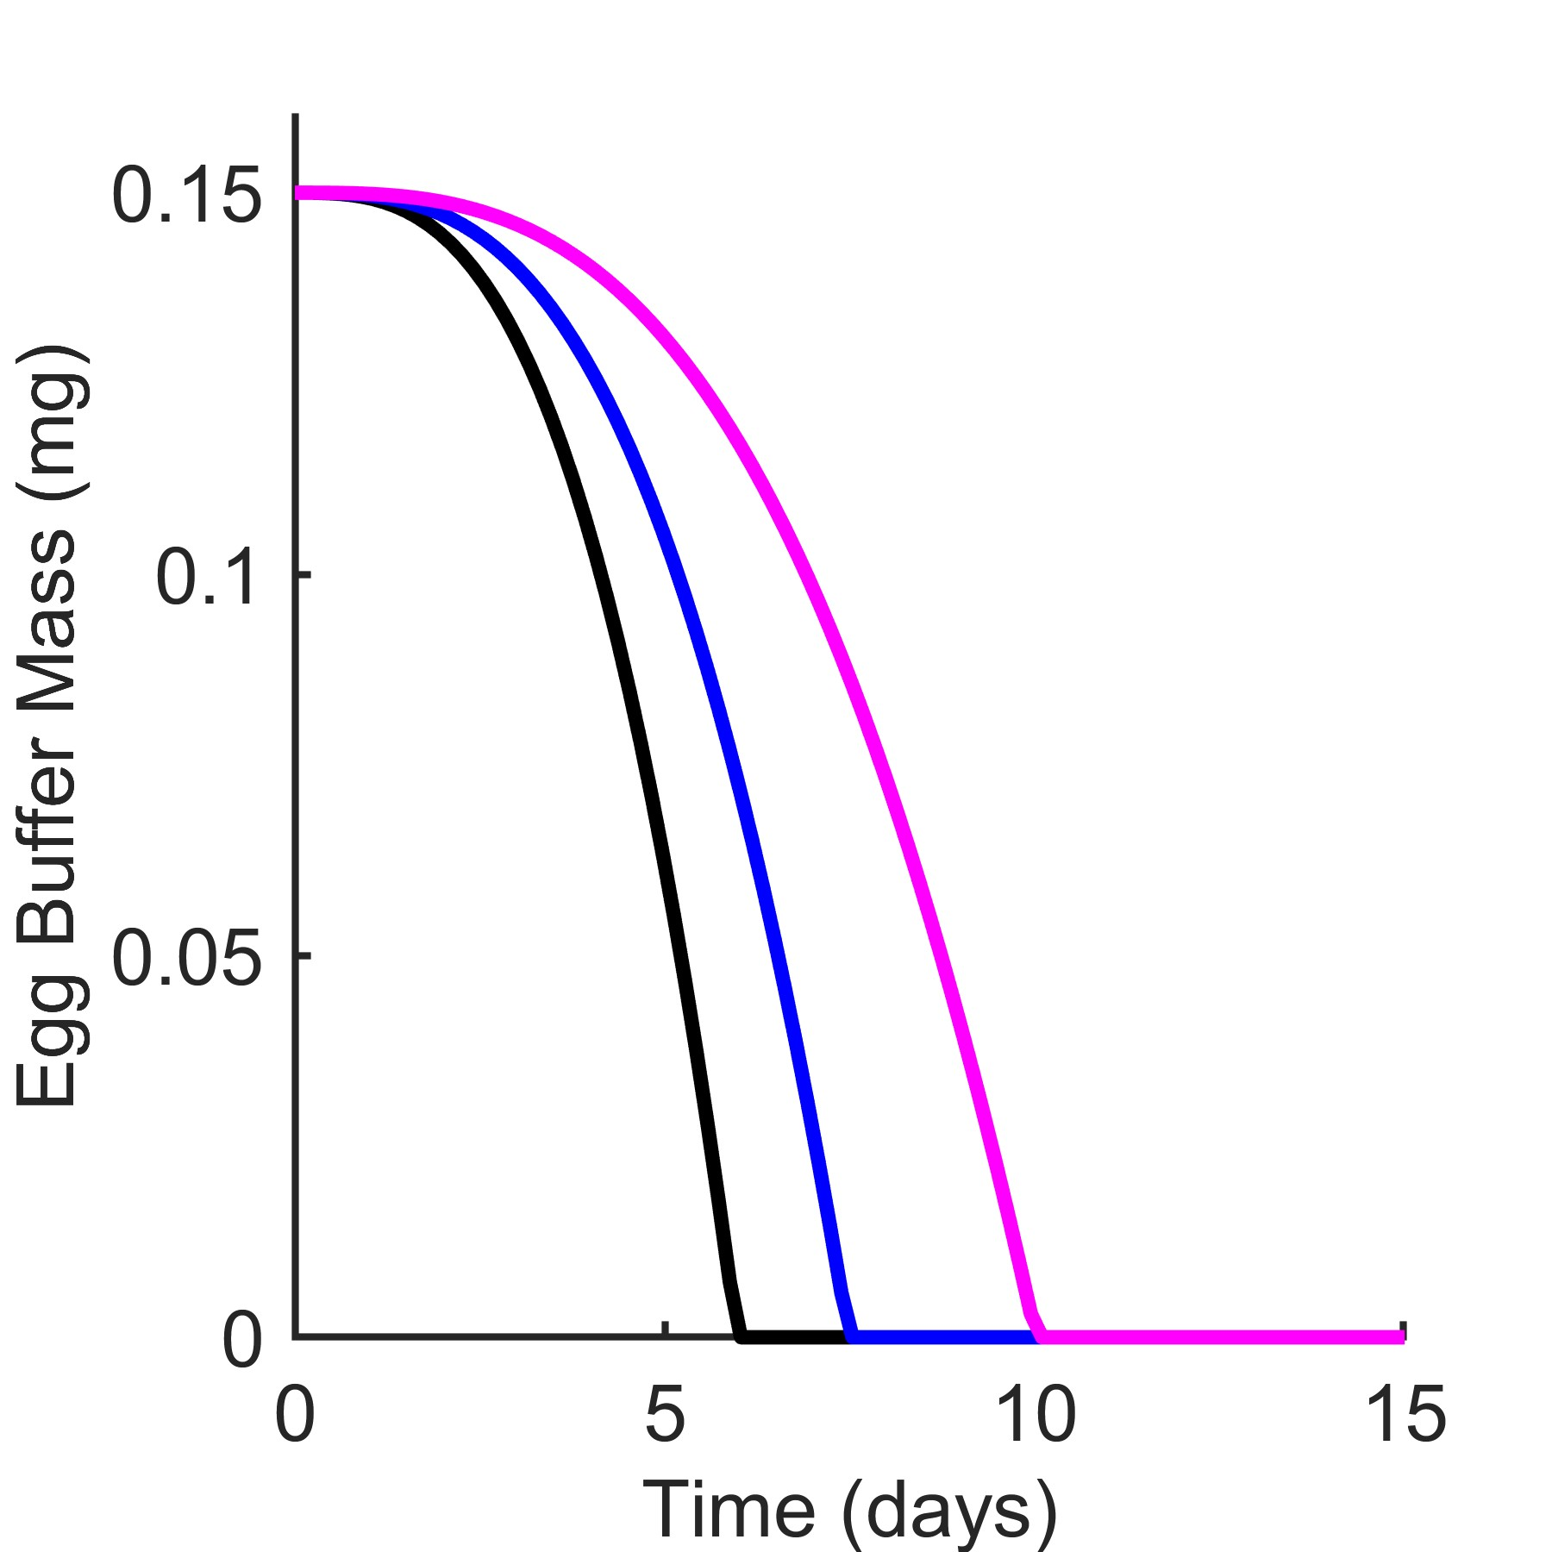
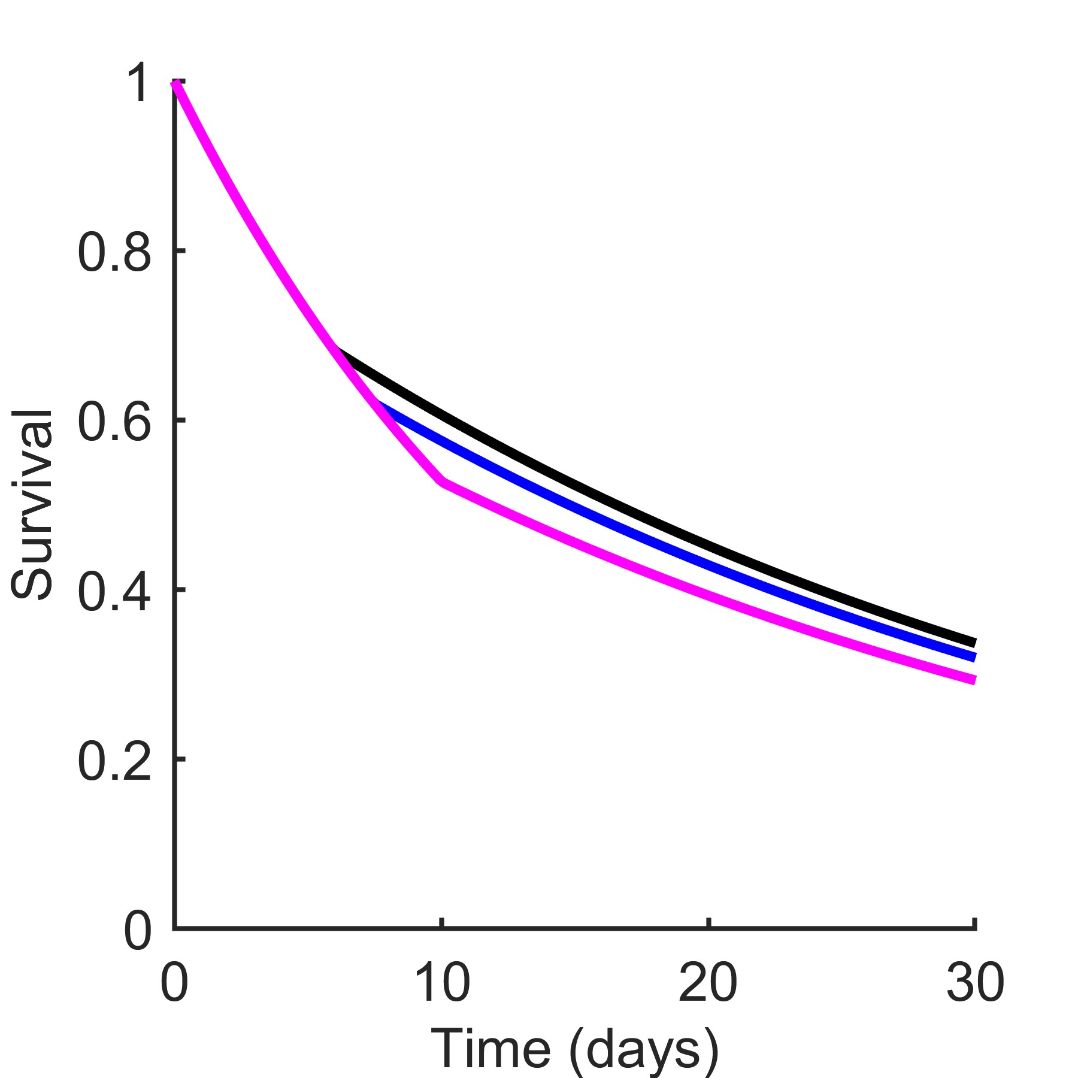
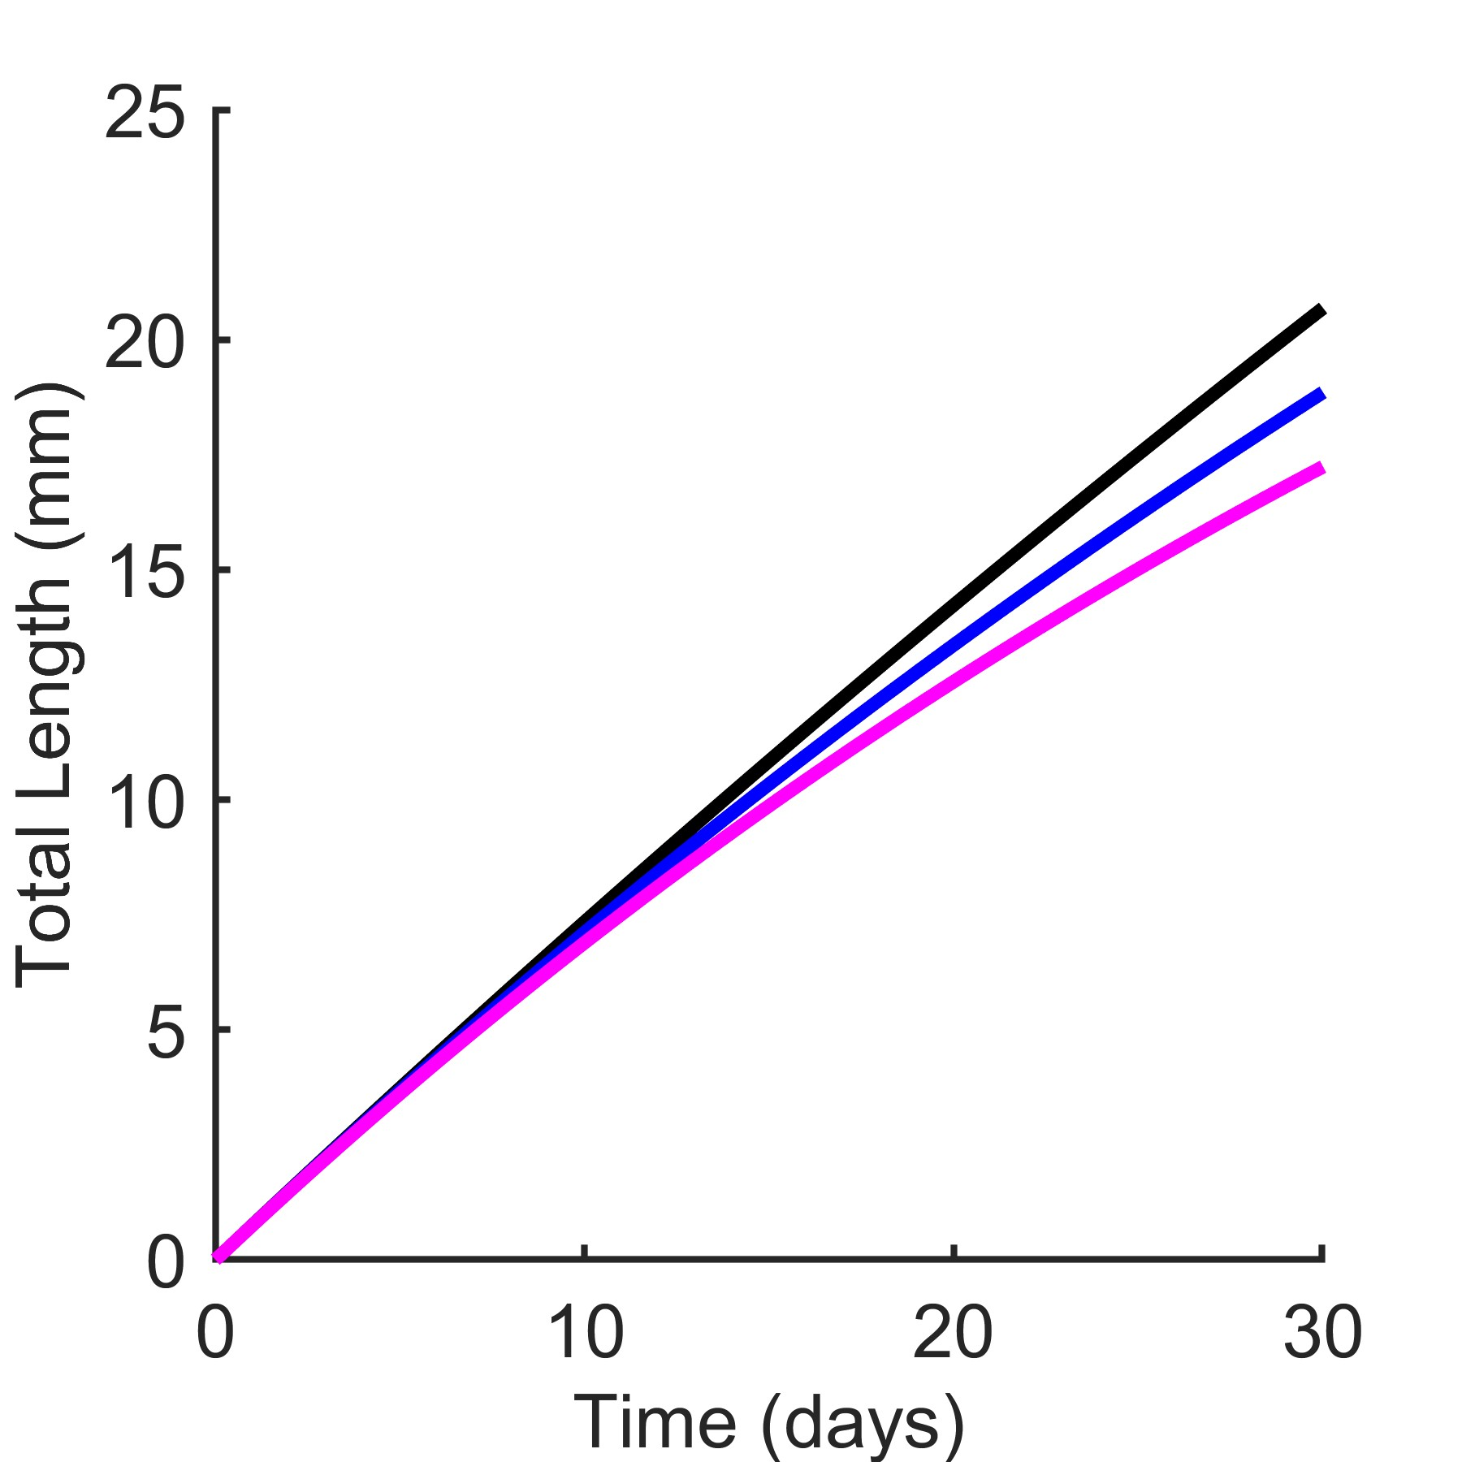
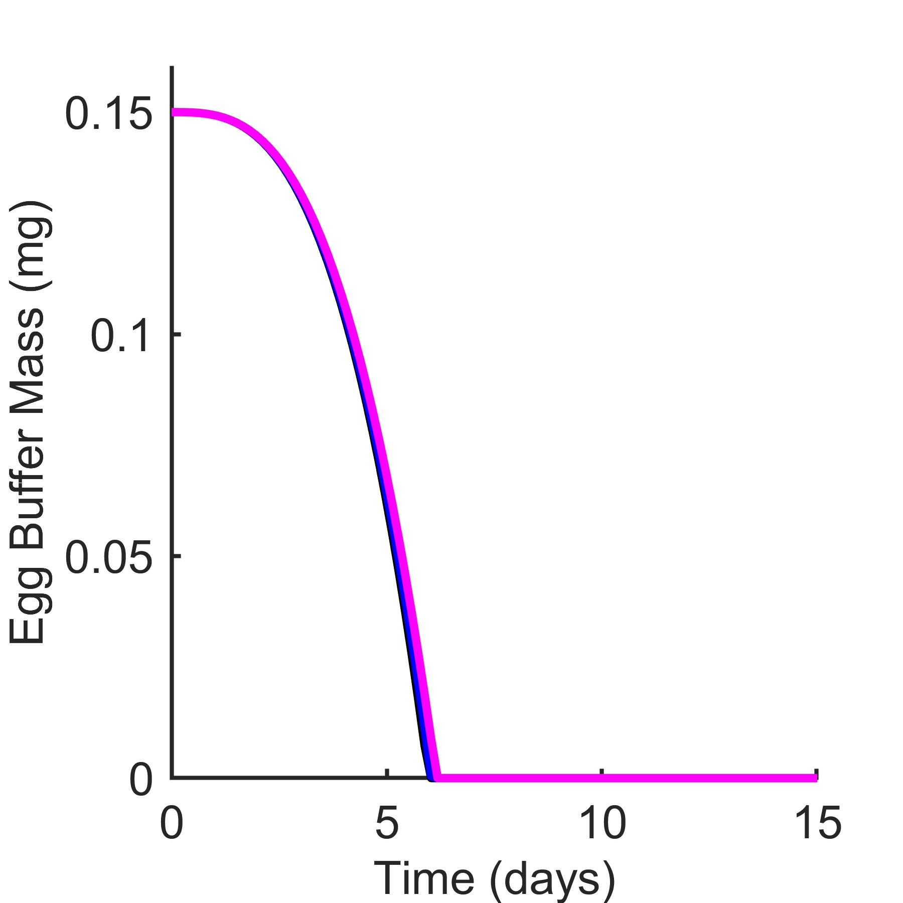
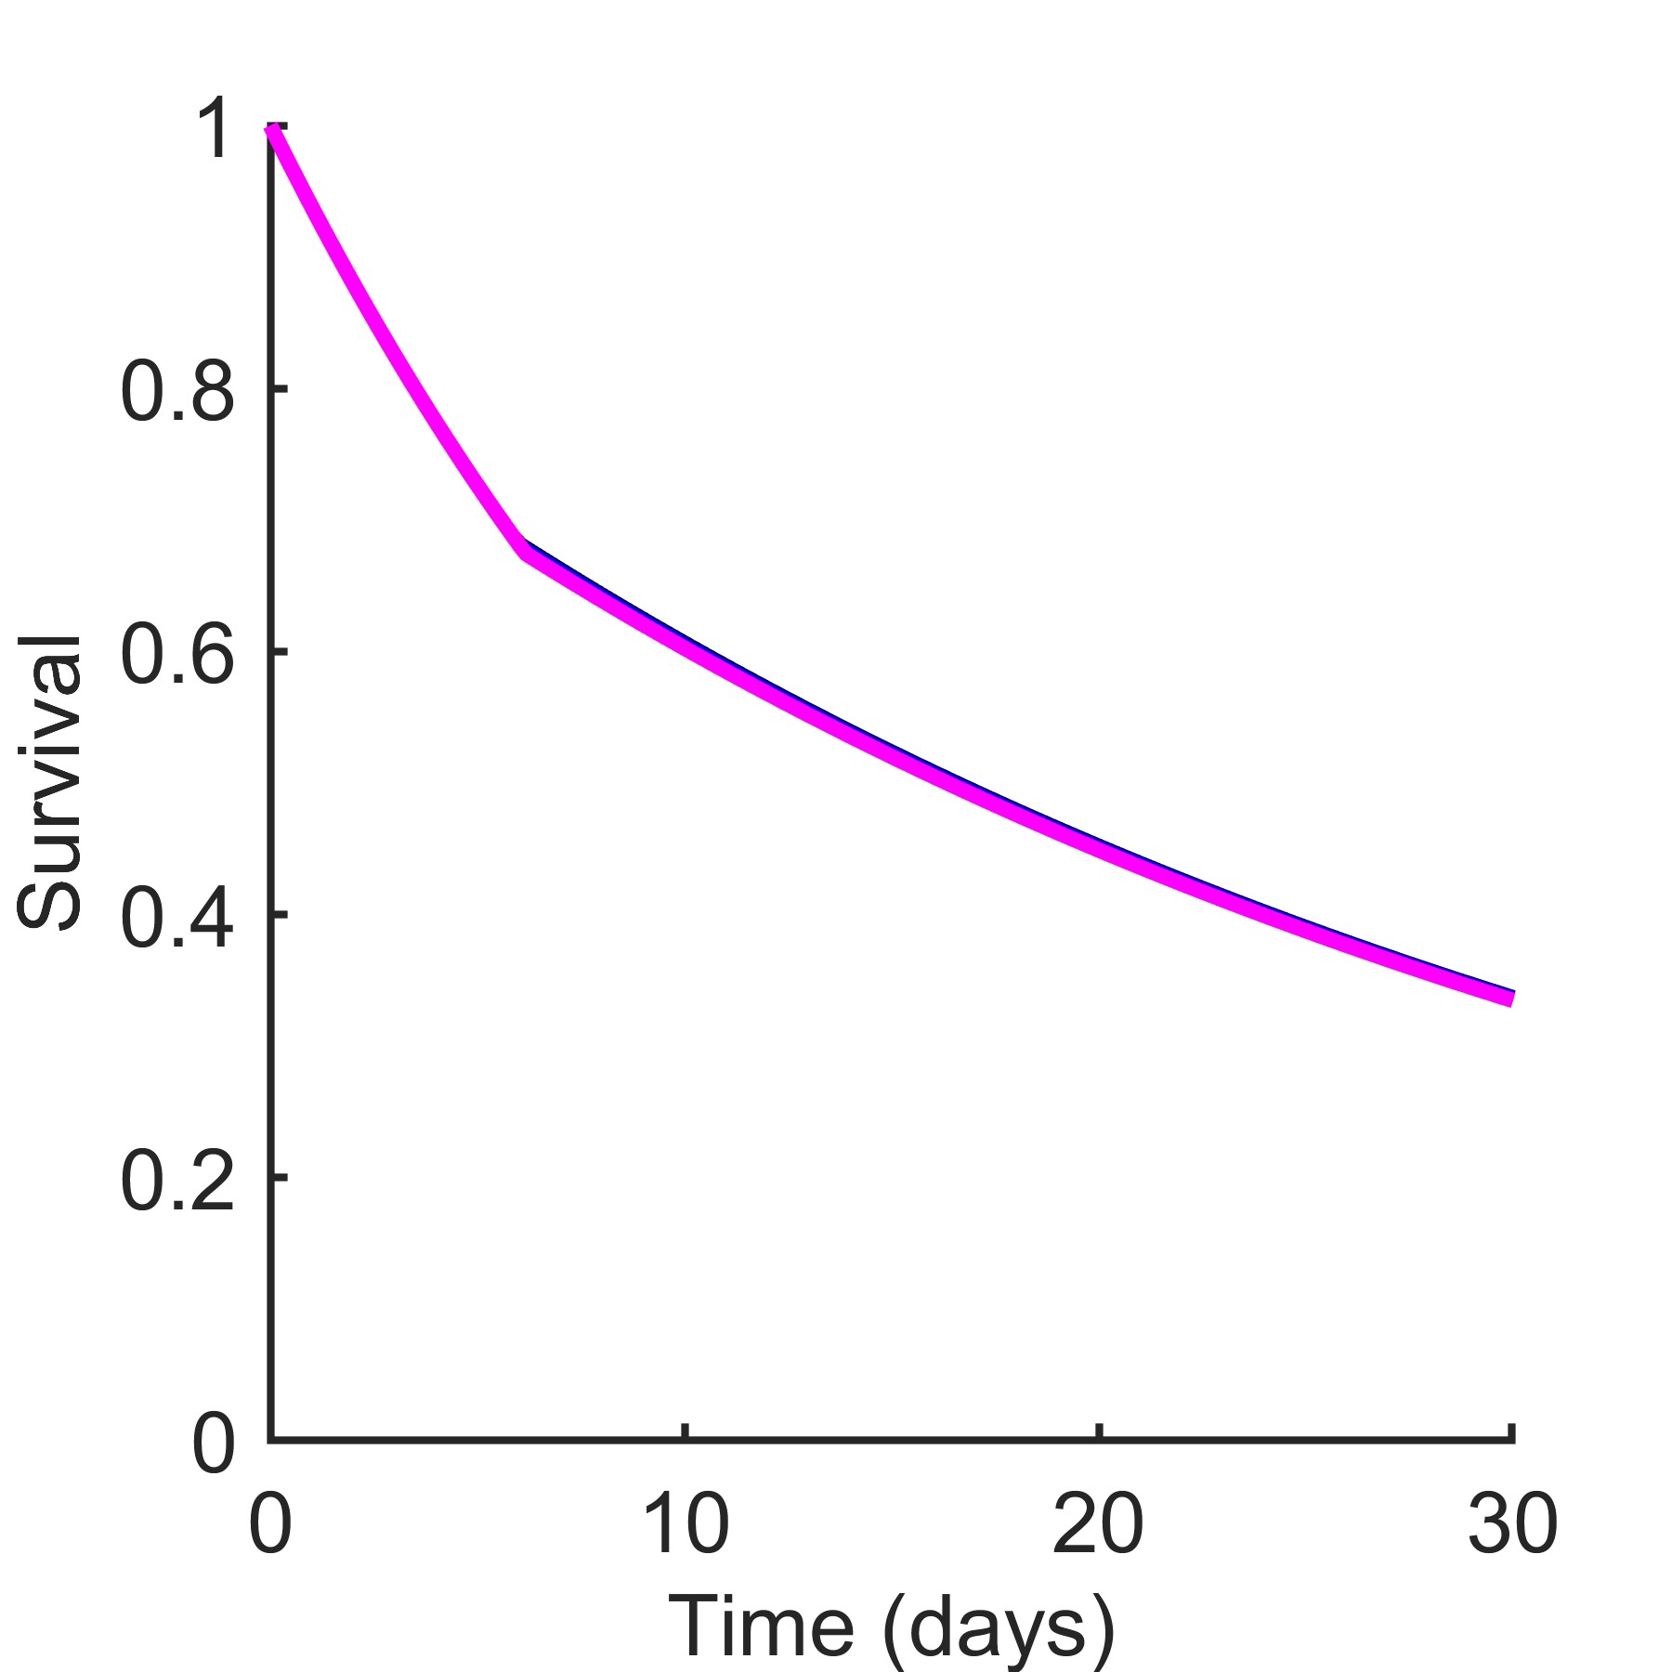
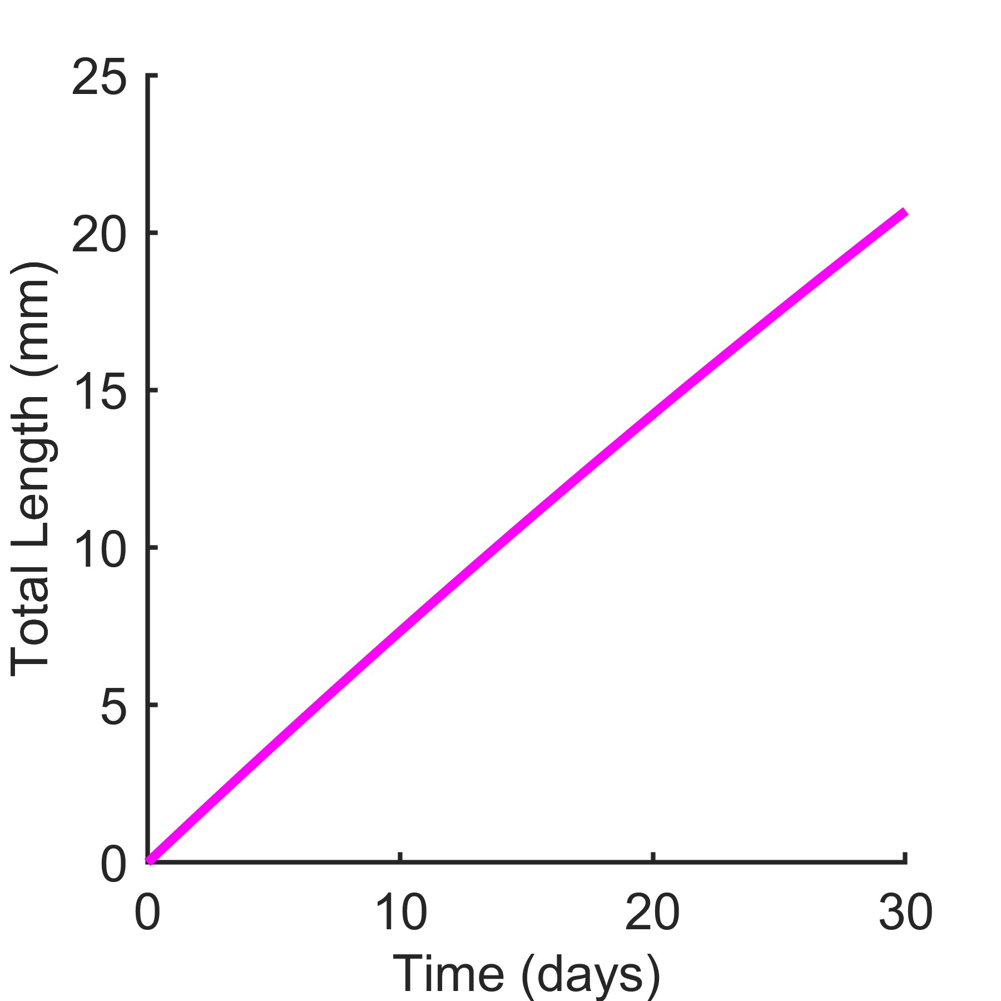
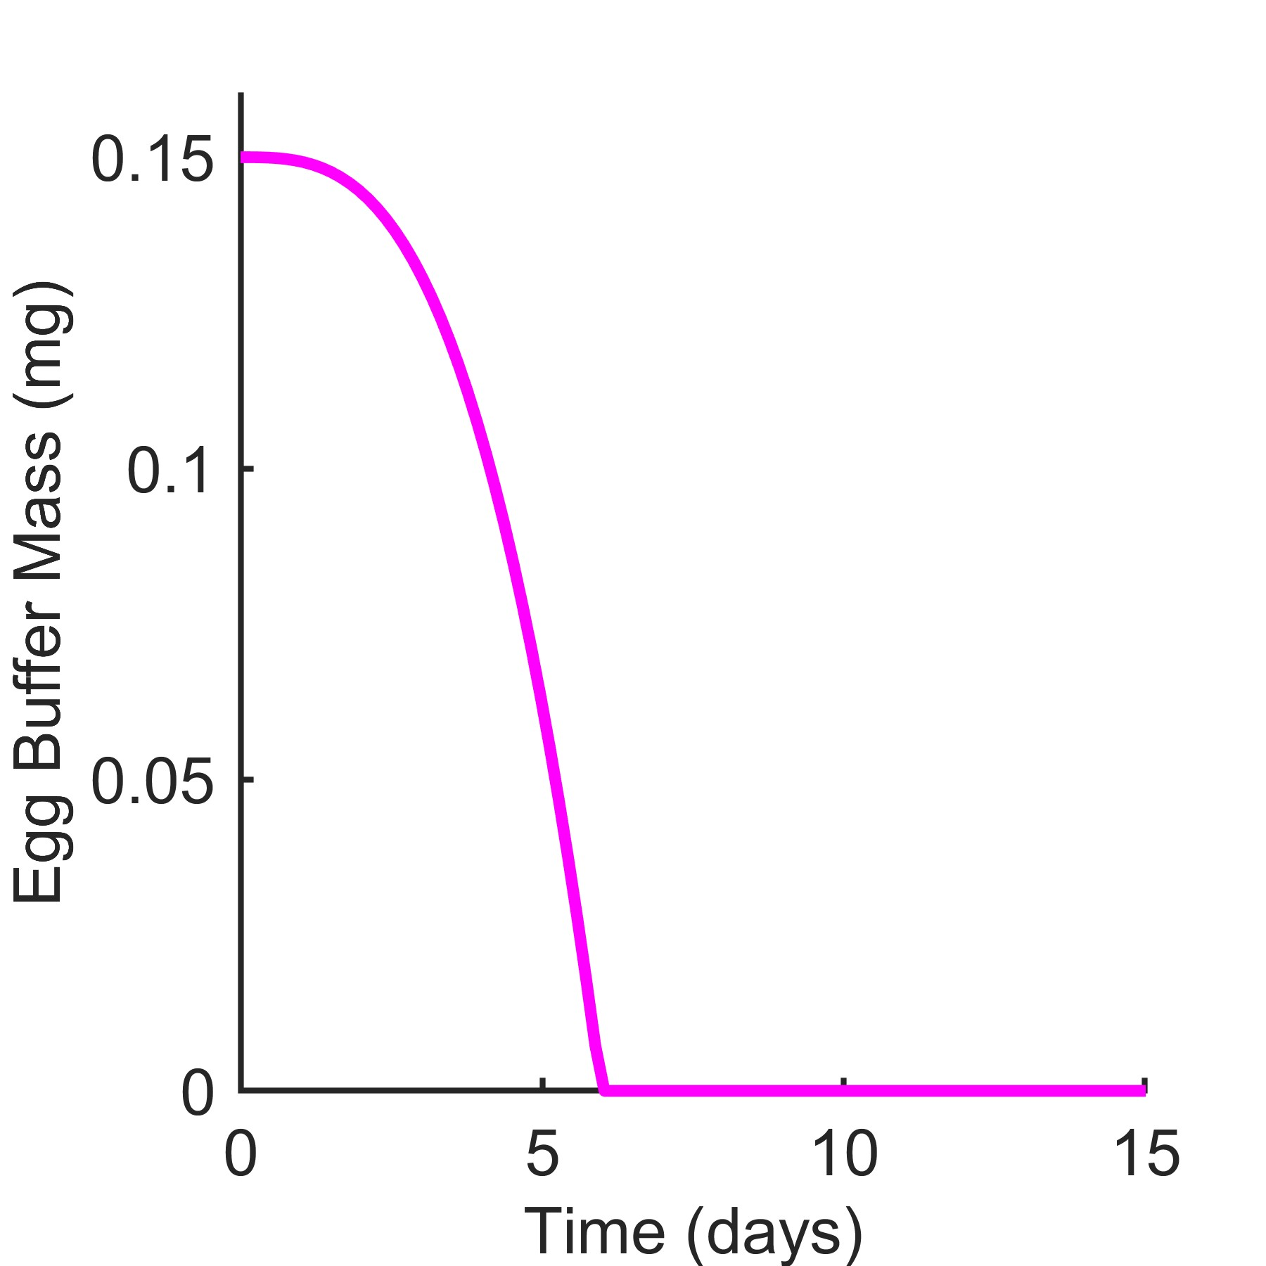
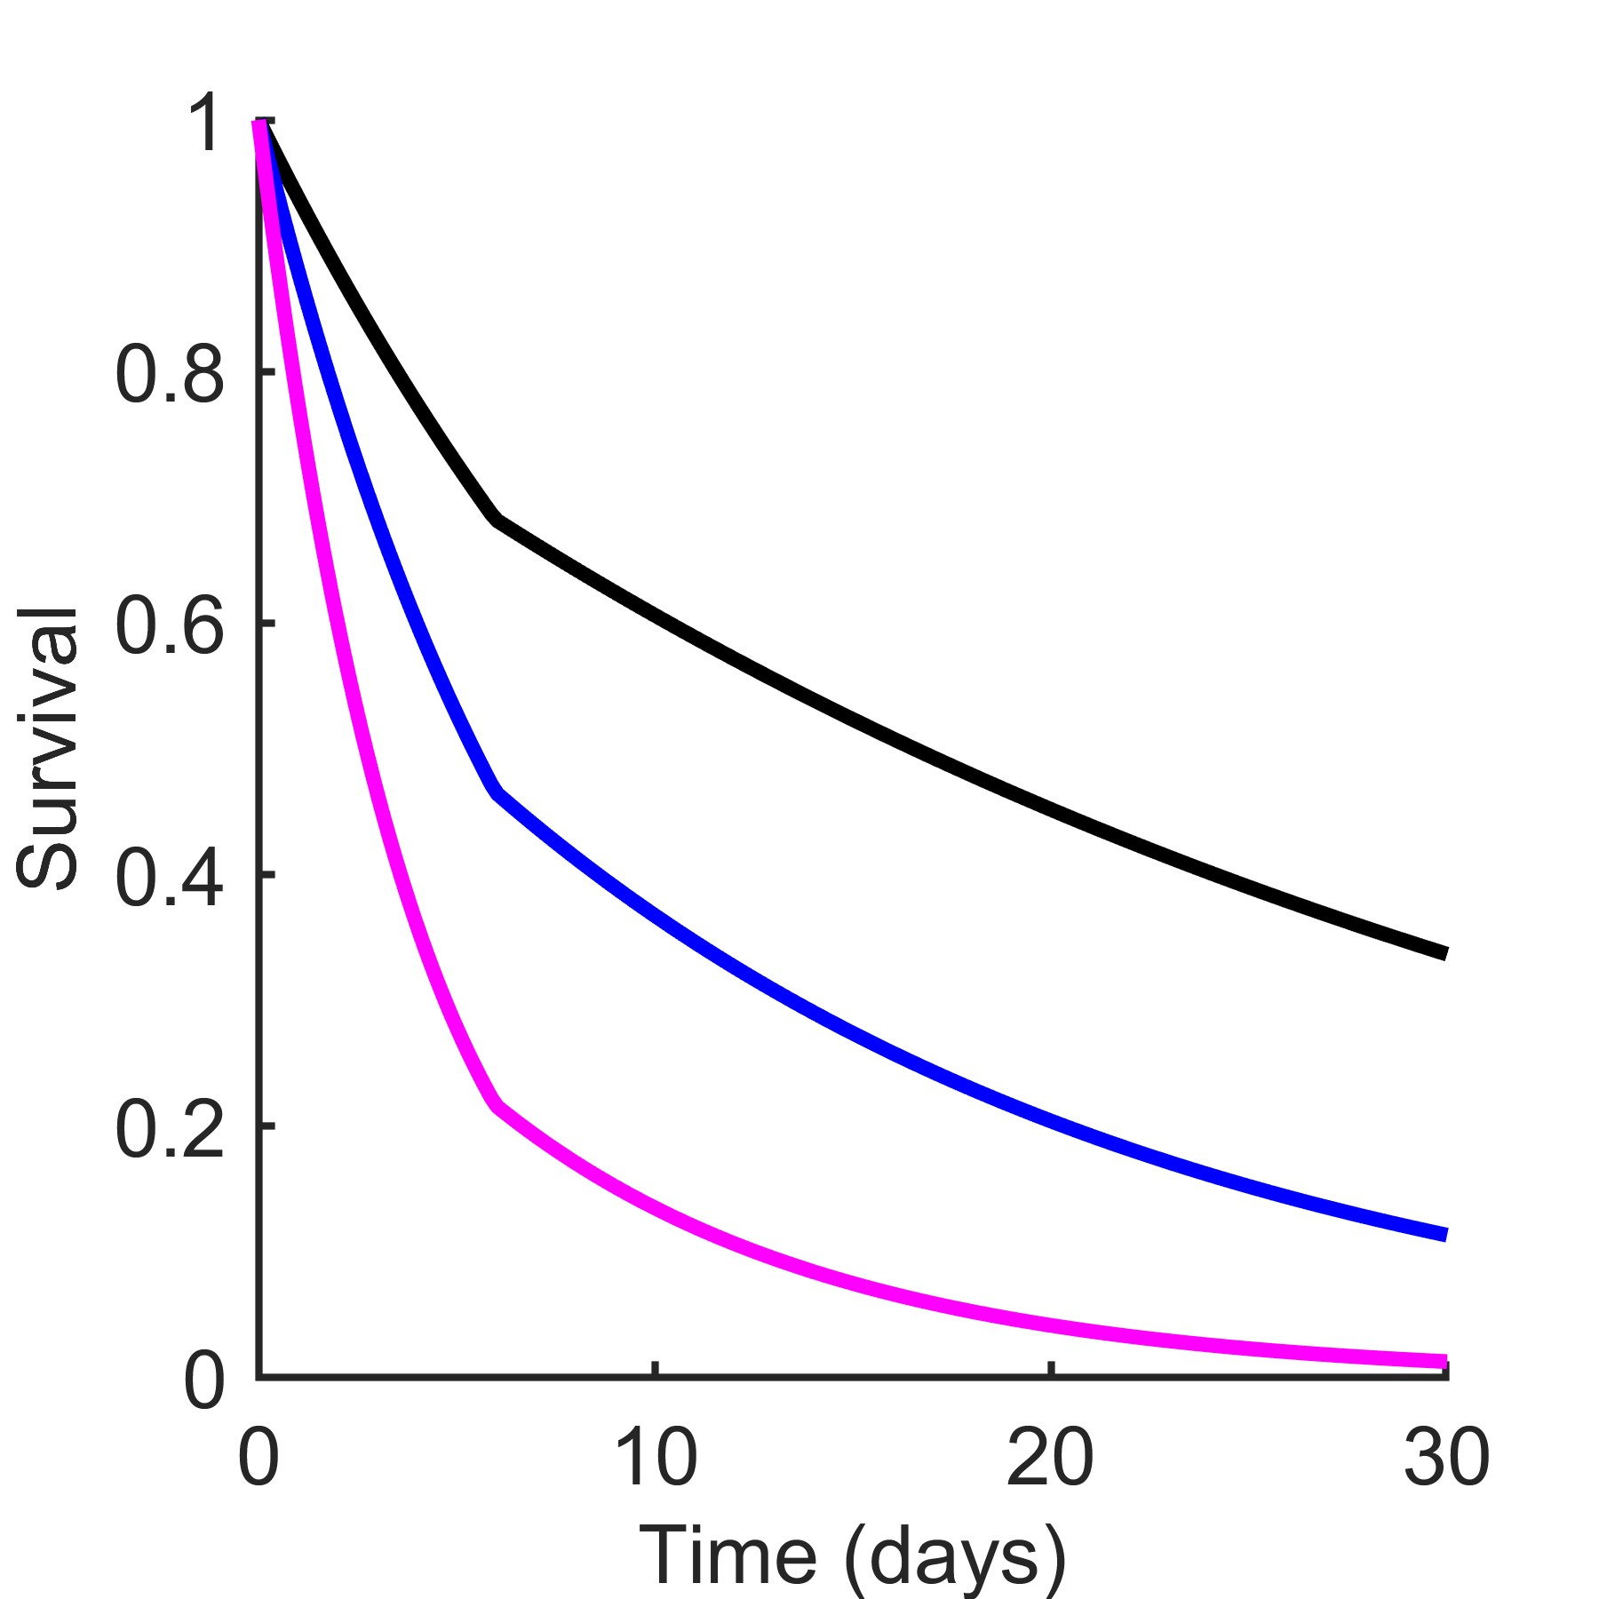
A
B
C
Jª_{Am} = 0.333 (base model)
Jª_{Am} = 0.266
Jª_{Am} = 0.200
D
E
F
J^{v}_{M} = 0.0214 (base model)
J^{v}_{M} = 0.0428
J^{v}_{M} = 0.0856
G
H
I
μ_{emb} = 0.06, μ_{lar} = 0.03 (base model)
μ_{emb} = 0.12, μ_{lar} = 0.06
μ_{emb} = 0.24, μ_{lar} = 0.12

